Slide 1

AI-Based Real-Time Driver Safety Monitoring and Risk Assessment System
Presented by:
Kurakula Akhilesh
Batch.No : 480
Innomatics Research Labs

Slide 2

About me
My Name is Kurakula Akhilesh
I have graduated with a Bachelor of Technology (B.Tech) in Computer Science from Gokaraju Rangaraju Institute of Engineering and Technology.
I aspire to become a Data Scientist to explore large datasets, perform analysis, create meaningful reports, and develop automation solutions.
LinkedIn :
https://www.linkedin.com/in/akhilesh-kurakula/

Slide 3
Agenda
Introduction
Problem Statement
Technologies Used
System Architecture
Drowsiness Detection
Yawning Detection
Head Distraction Detection
Phone Usage Detection
Advantages
Limitations
Future Enhancements
Conclusion

Slide 4
Introduction
1.35M+
Road deaths per year globally.
30%
Caused by drowsy driving.
Real-Time
AI-based detection.
Every year, impaired and inattentive driving claims over a million lives worldwide. Traditional driver assistance relies on reactive hardware sensors this project takes a proactive, vision-based approach. By continuously analyzing a driver’s face and in-cabin environment, the system detects drowsiness, yawning, head distraction, and phone usage in real time triggering immediate audible alerts before a critical event occurs.

Slide 5
Problem Statement
Drowsy Driving
Micro-sleeps last 4–6 seconds. At 60 mph, that is 176 ft driven completely blind.
Phone Distraction
Visual, cognitive, and manual distractions triple the crash risk.
Yawning / Fatigue
Frequent yawning precedes sleep onset—an early-warning signal often missed.
Gaze Deviation
Looking away from the road for >2 s is as dangerous as driving drunk.

Slide 6
Technologies Used
OpenCV
Video capture, frame processing, bounding-box drawing, and display loop.
MediaPipe
478-point 3-D face mesh; EAR / MAR computation and head-pose inputs.
YOLOv8
Real-time object detection (cell phone); runs on GPU via CUDA.
PyTorch
GPU/CPU device selection & model hosting for YOLO inference.
Pandas
Per-frame telemetry logging; CSV read/write for session replay.
Matplotlib
Post-session analytics: bar, pie, heatmap, signal and risk charts.

Slide 7
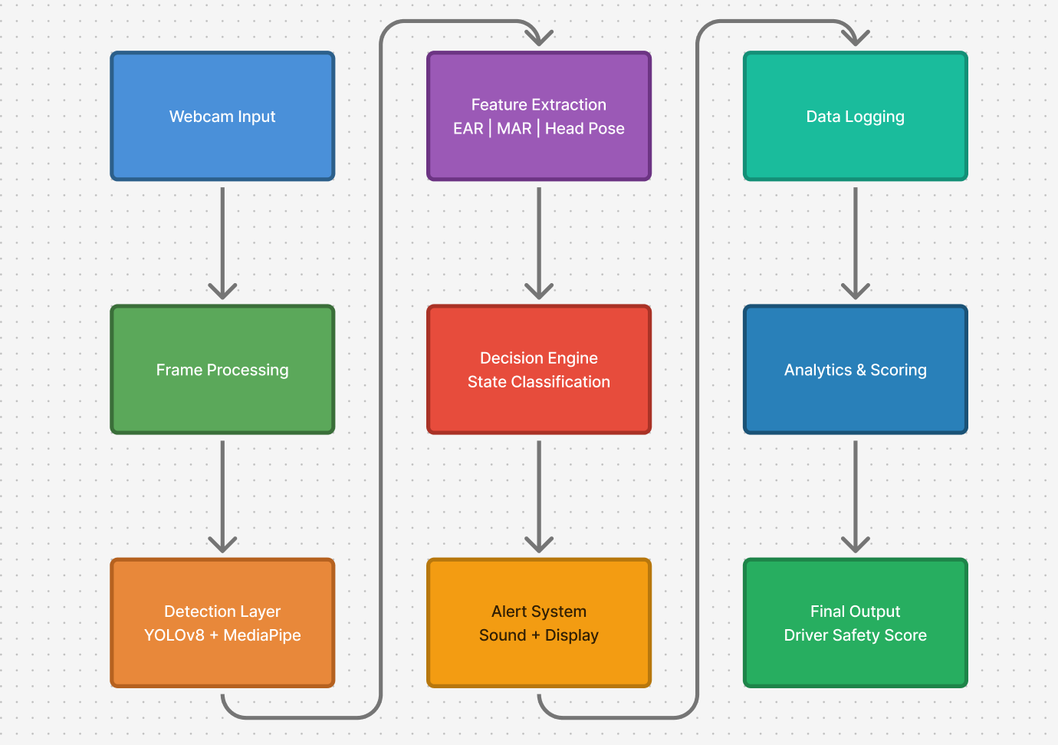
System Architecture

Slide 8
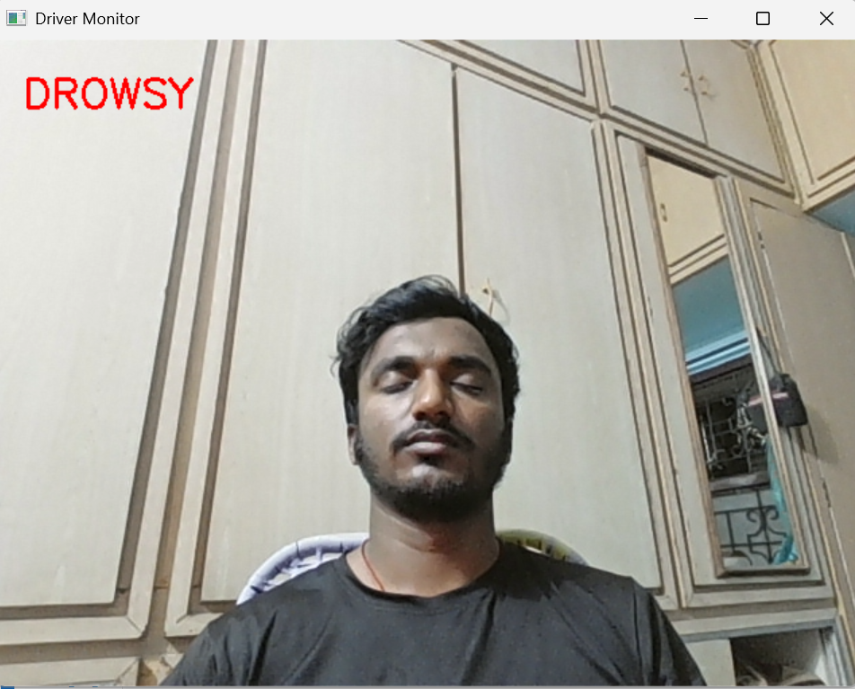
Drowsiness Detection
1. Real-Time Drowsiness Detection
The system successfully detects closed eyes continuously, identifying a drowsy state in real time.
This shows that the EAR (Eye Aspect Ratio) + frame threshold logic is working effectively.
2. Immediate Alert & Safety Response
Once drowsiness is detected, the system instantly labels the driver as “DROWSY” on screen.
This enables early warning, helping prevent accidents by alerting the driver at the right moment.

Slide 9
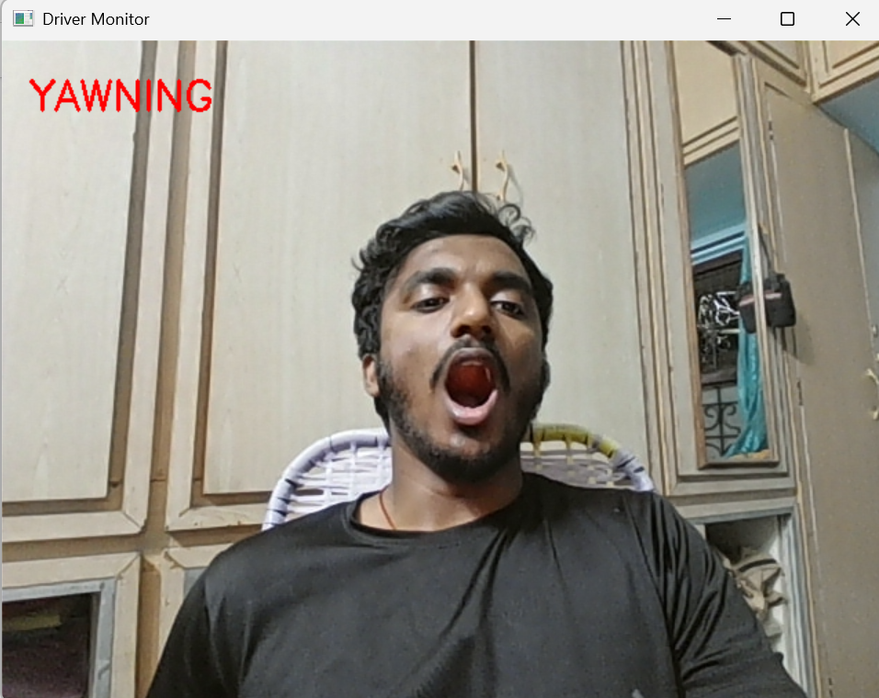
Yawning Detection
1. Yawning Detection Using Mouth Aspect Ratio (MAR)
The system detects yawning by measuring mouth opening (MAR) using facial landmarks.
A wide-open mouth sustained over multiple frames is correctly classified as “YAWNING.”
2. Early Indicator of Driver Fatigue
Yawning is identified as a pre-drowsiness signal, helping detect fatigue before sleep occurs.
This allows the system to warn the driver early, improving overall road safety.

Slide 10
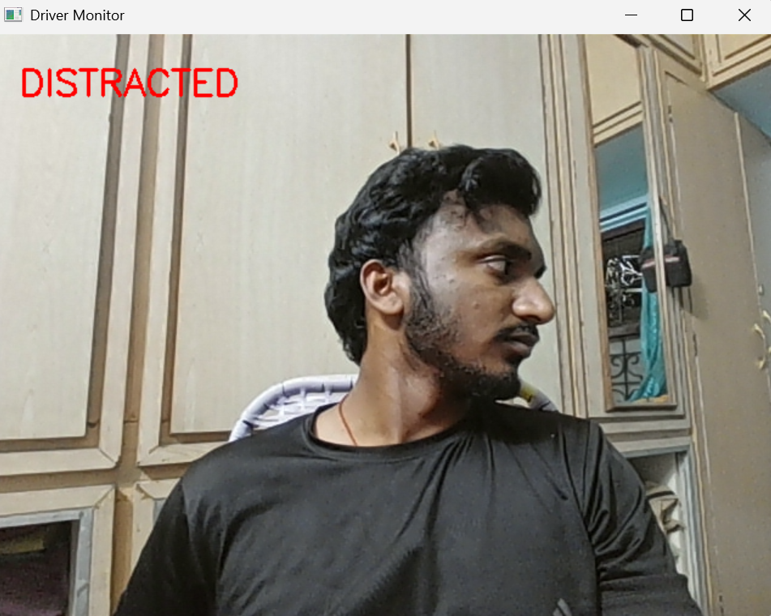
Head Distraction Detection
1. Head Pose–Based Distraction Detection
The system tracks head rotation (yaw & pitch angles) to detect when the driver looks away from the road.
A sustained deviation beyond threshold is classified as “DISTRACTED.”
2. Continuous Monitoring for Safer Driving
Distraction is only triggered after consistent head movement across multiple frames, reducing false alerts.
Helps identify attention loss in real time, improving driver safety and awareness.

Slide 11
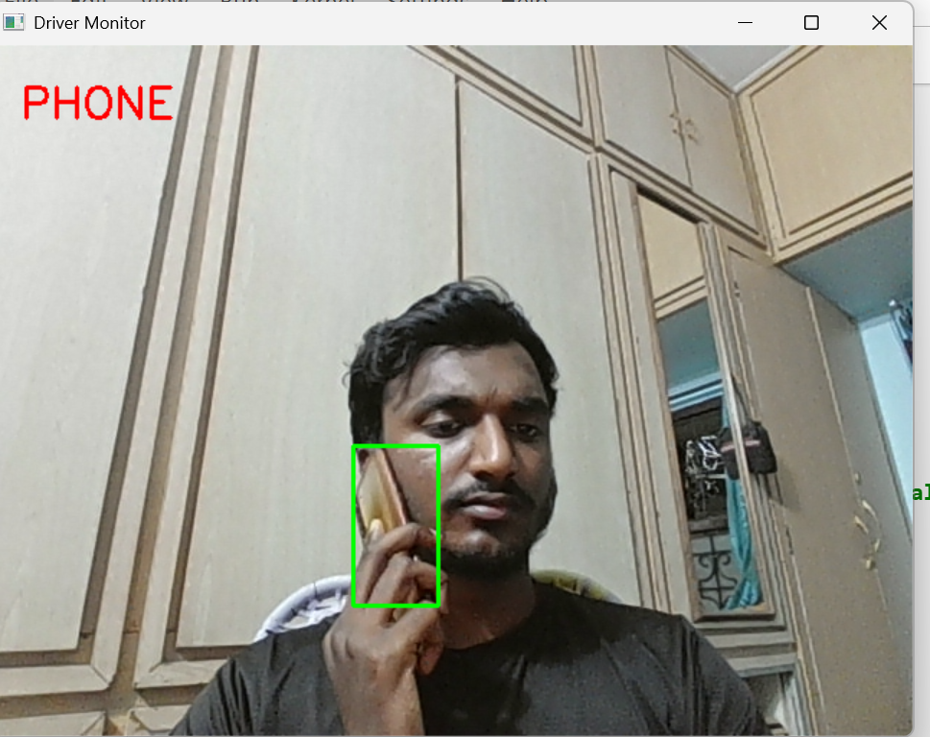
Phone Usage Detection
1. Real-Time Mobile Phone Detection (YOLO Model)
The system uses YOLO object detection to identify a mobile phone in the driver’s hand.
A bounding box is drawn around the detected phone, and the state is classified as “PHONE.”
2. High-Risk Behavior Identification
Using a phone while driving is detected as a critical distraction with higher penalty weight.
Enables instant alerts, helping prevent accidents caused by reduced driver attention.

Slide 12
Advantages
Non-Intrusive:
The system works using only a camera, without requiring wearables or special sensors.
Multi-Hazard:
Detects multiple risks simultaneously, including drowsiness, yawning, distraction, and phone usage.
Persistent Log:
Saves driver data over time, allowing long-term behavior tracking and safety analysis.
Modular:
The system is built in separate parts, allowing easy updates, tuning, or replacement of individual components.
Low Cost:
The system runs on standard hardware like a webcam and CPU, with optional GPU for better performance.

Slide 13
Limitations
⚠ Lighting Sensitive
Face landmark accuracy degrades significantly in low-light environments or heavily backlit conditions without specialized sensors.
⚠ Occlusion Failures
Wearing dark sunglasses or face masks can block key landmarks, potentially disabling the eye and mouth detection logic entirely.
⚠ No Night Vision
Standard RGB webcams perform poorly at night. The system currently lacks infrared (IR) support for true 24-hour monitoring.
⚠ Single Occupant
The system is configured for one driver (max_faces=1). Passenger interference or movement in the background can occasionally cause false positives.

Slide 14
Future Enhancements
1. IR / Night Mode
Add an infrared camera channel or low-light image enhancement for 24/7 operation in total darkness.
2. Cloud Dashboard
Stream session data and real-time alerts to a fleet-management portal for remote monitoring and safety audits.
3. Mobile Port
Make the system work directly on smartphones.
4. Emotion & Stress
Add facial action unit analysis to detect signs of road rage, extreme stress, or cognitive overload.

Slide 15
Conclusion
A complete, real-time, vision-only driver safety pipeline.
This project shows that even with basic hardware like a webcam, we can build an effective driver safety system using AI models like YOLOv8 and MediaPipe. It can detect risky behaviors such as drowsiness, distraction, and phone usage in real time. The system is flexible and can be improved further with additional features in the future. Overall, this solution helps in reducing accidents and improving road safety.
System Highlights
4 Hazards Detected: Drowsiness, Yawning, Distraction, and Phone Usage.
Safety Score 0–100: Real-time quantified driver performance.
6-Chart Analytics: Detailed post-drive breakdown for behavior review.
Extensible & Modular: Built for future hardware and software integration.

Slide 16
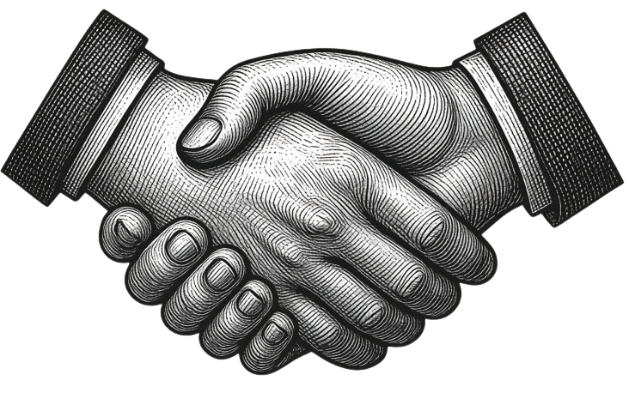
THANK
YOU

